Slide 1
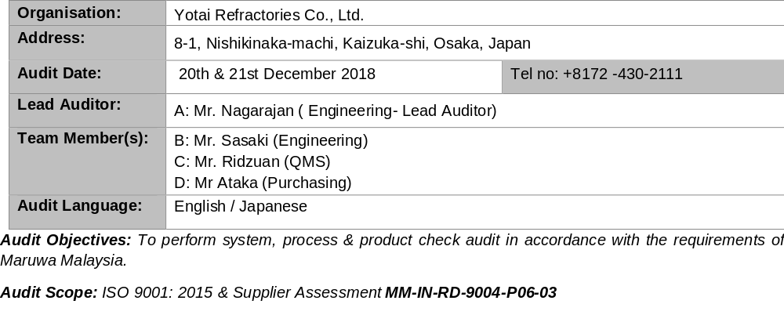
SUPPLIER AUDIT VISIT

Slide 2
Process Flow Overview
Auto weight controller
Magnetic bar
Raw Material
Mixing
Remove iron
Mesh
Pressing
Pressed machine similar with magnet machine
Machine is auto arrange with rotating motor. Thickness check 100% with laser
Bulk density after pressed sampling at this point
Packaging and Shipment
Bending Strength/ Bulk Density
VISUAL INSPECTION
Firing/ Elevator
3 hours to remove moisture

Slide 3
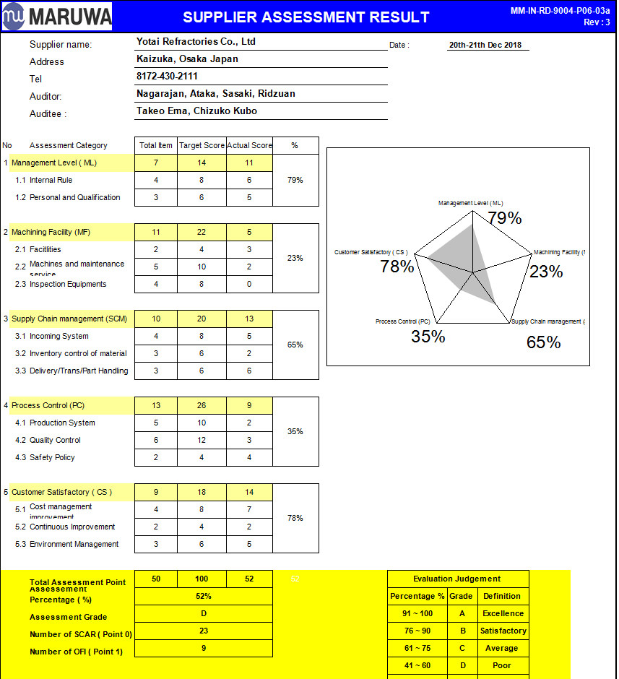
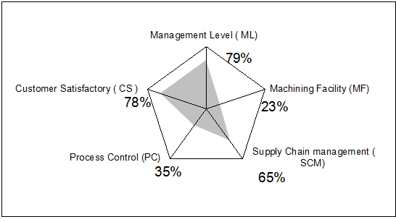
Systemic Audit Results
Results: Only 50% conform to ISO 9001:2015.
Major non conformance on the area of process control and machinery.
1. No procedure and WI/OPL available and presented at line. Record only available for testing data (pencil written)
2. Machine PM, machine specification not available
3. Inspection instrument no proper maintenance (eg: calibration)
Yotai have no plan for transition ISO9001:2015 due to lack of resources.
Good point: Support from all staff and engineer, process very open to share the process and machine well.

Slide 4
Process Audit Results
Root cause / Problem being identified :
Specification too large and not revised accordingly allowed NG setter flow out to Maruwa
Yotai Action |  |  | Maruwa Action
Item | Before | After | Item | Action
Bulk density after pressed | ≧2.92 | Data showed good condition ≥2.98 Request Yotai immediately used this spec, revise QDS and internal spec table | Incoming check | 1. To performed Bulk Density 2. To performed Bending Strength IQC to provide sampling plan based on the production lot
Bulk density after firing | ≧2.85 | Evaluation showed good condition ≥2.89 Request Yotai to confirm the spec, revise QDS.
 |  |  | Additional request to Yotai: 1. QDS shall be approved by Maruwa. 2. Inspection data and manufacturing record shall available prior to shipment
 | Sampling quantity 1pcs per day (by shipment lo) | Request Yotai increase the frequency by lot / by batch no. Sampling plan included in QDS
Bending strength | No Spec | Good data showed above 22MPa Request Yotai to further evaluate and confirm the spec, revise QDS
Recommendation:
1. Under management consideration, suggested to qualified 2nd source for setter as the high risk impact to product.

Slide 5
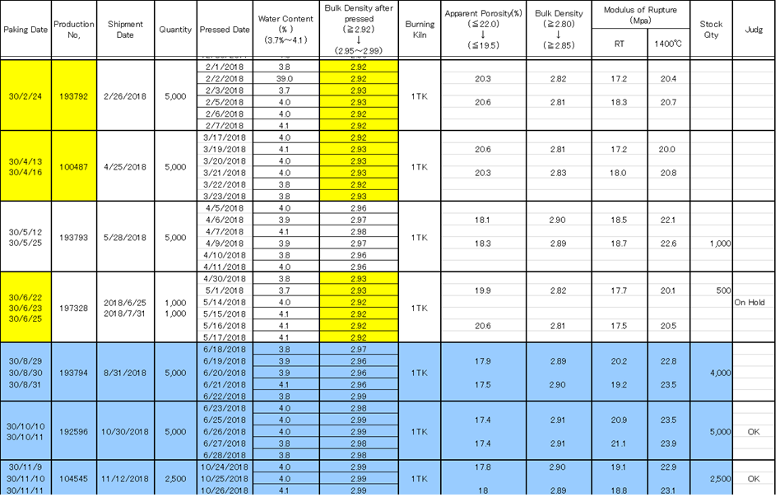
Disposition of On Hold Lots at Maruwa
ON HOLD LOT
To be tested for 3 categories:
Bending strength
Specific gravity
Firing evaluation
NG lot to be return back to Yotai

